Slide 1
ASP_PROJECT_2021 “TakeAway”
By Di Falco Simon & Huygebaert Amandine

Slide 2
Statement

Slide 3
Analysis
Thinking before you program
object-oriented language is complex
Define the scope of work with the client
COMMUNICATION !
Whit what?
UML language
Standard modeling language
Diagram
It exists thirteen diagram.
Three of them
Use case diagram, class diagram and sequence diagram.

Slide 4
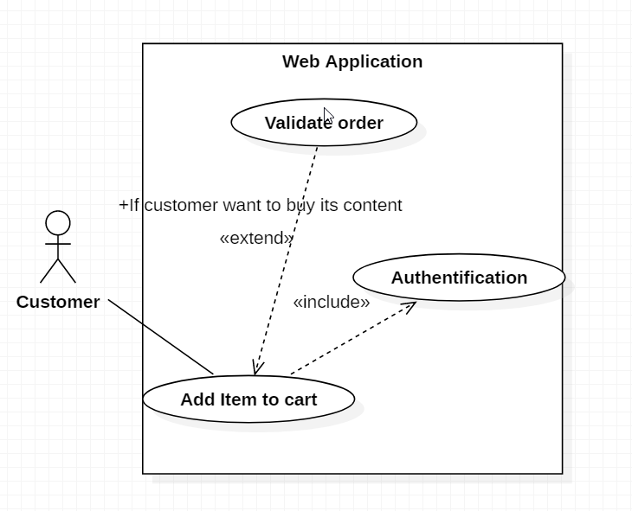
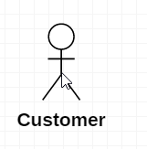
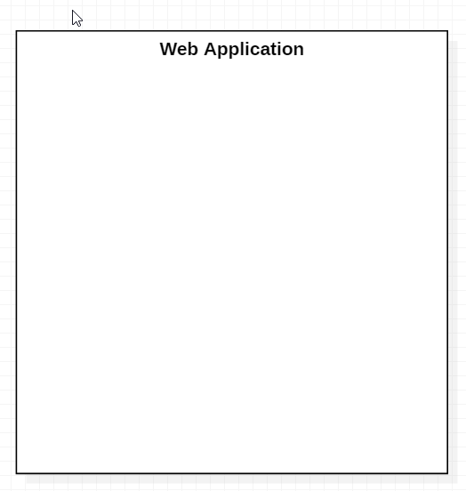

Use case diagram : theory
For what purpose?
Starting point
Presents the features clearly to the customer
How does it work ?
Include & extend case
Actor
System
Use case
« what can the actor do in the system? »
« Who use the system ? »
Not always humain !
« What is the project? »

Slide 5
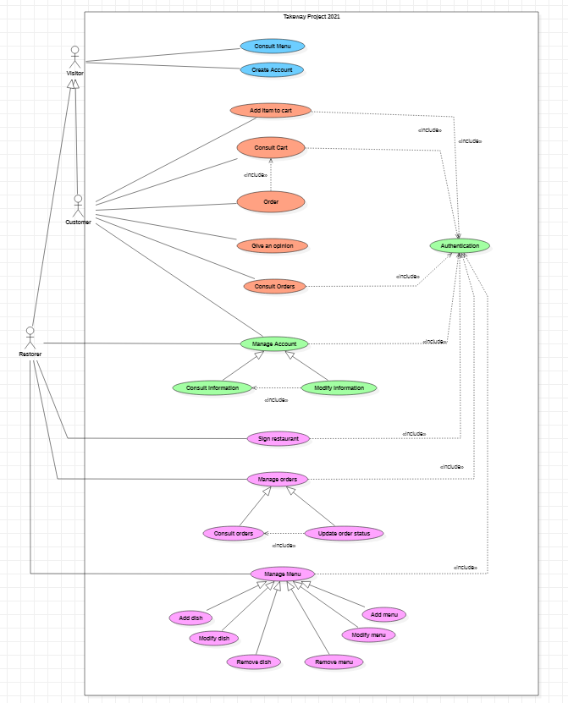
Use case diagram : our
Visitor
Customer
Restorer

Slide 6
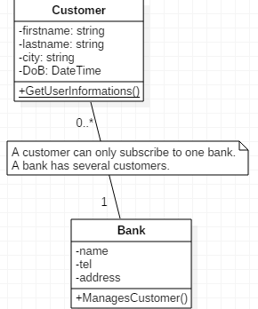
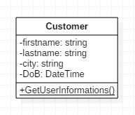
Class diagram : theory
For what purpose?
Models static classes and interfaces and the relationships between them.
How does it work ?
Class
Privates attributes
Static operation
Association

Slide 7
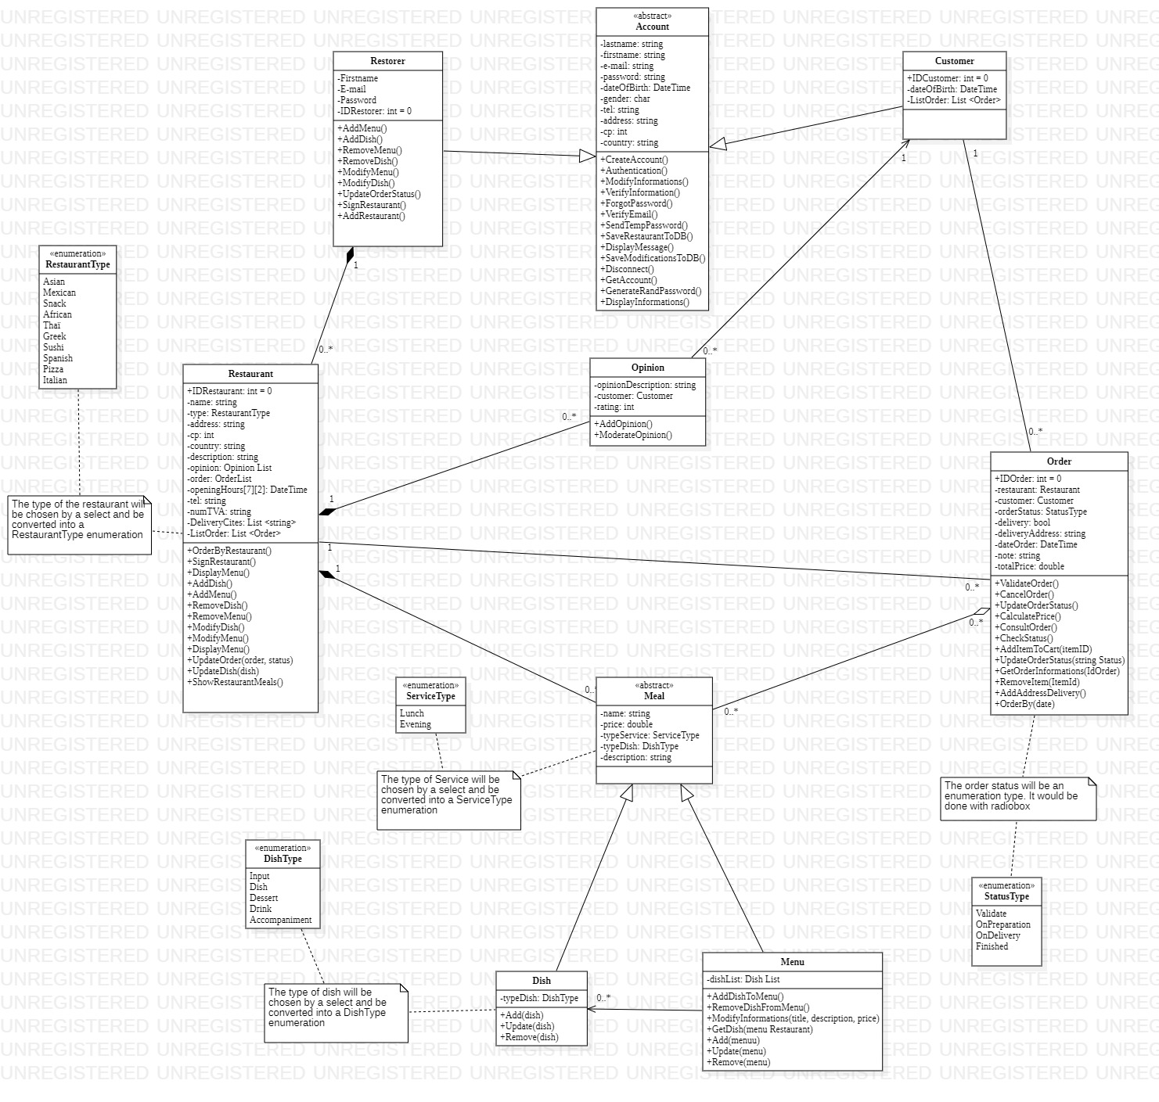
Class diagram : our
generalization and specification
Restorer and customer are account
Composition
The meals belong to the restaurant and if it is destroyed they are also
Aggregation
Order contains meals

Slide 8
Sequence diagram : theory

Slide 9
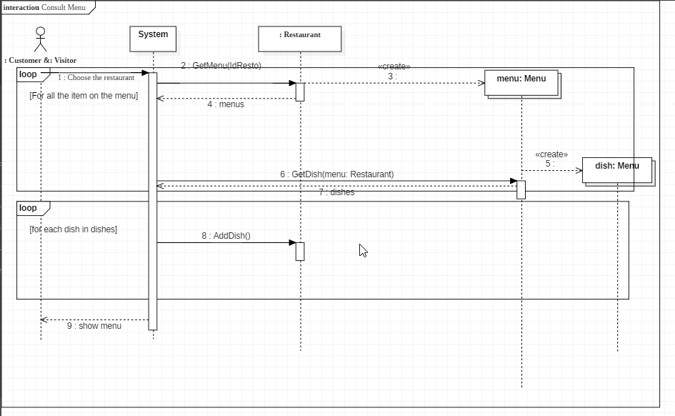
Sequence diagram : two of our own

Slide 10
Demo
Run ASP_PROJECT

Slide 11
Conclusion

